Slide 1
HR Part II
Lesson 02: Performance Management and XML

Slide 2
Performance Management as an Administrator and End-User Lesson Objectives:
After completing this lesson, participants will be able to -
Describe the Principles and Tools of Performance Management
Establish Workflow and Recording Evaluations with the Performance Form
Create a Performance Form
Describe Roles for Performance Management and Accessing the Document Type Definition (DTD)

Slide 3
Describing the Principles and Tools of Performance Management
About This Topic
In this lesson, you learn about the function and basic principles of Performance Management, how to navigate the performance form, and how to convert PMv11 to PMv12 Acceleration.
Objective(s)
After completing this lesson, you will be able to:
Explain the basic principles of Performance Management
Convert a Performance Management form to PMv12 Acceleration

Slide 4
Performance Management
Performance Management enables the customer to measure individual employee contributions across their organization accurately and objectively. This helps the customer make decisions as to which employees to keep, reward, or select for targeted development. In this way, Performance Management transforms the employee review process.
Managers and employees use the performance review form to evaluate the employee’s effectiveness in achieving goals, core values, and job specific competencies. You can configure the form to automatically display goals from a goal plan. The customer can choose whether or not to link the form to a plan.

Slide 5
Basic Principles of a Performance Form
For most customers, the implementation of Performance Management follows Goal Management. Like Goal Management, Performance Management is a template-based module. In the instance, individual forms are created for individual employees from a configured template.
Unlike a Goal Plan, a Performance Management form can be routed from one user to another. Performance Management forms include signature and competency sections, and are associated with route maps. Performance Management forms can be permissioned section by section (and, in some cases, field by field) according to employee roles. Some types of Performance Management form sections appear only once in a form template, whereas other types appear multiple times.
Note:
Even though the terms “form” and “template” are often used interchangeably, it is important to remember this distinction. You create specific forms on the basis of generic templates.Usually, contextual information will help you determine which item is being discussed. For example, when a consultant speaks of Edward Employee's 2019 "form" the consultant is most likely referring to an actual form and not a template. But when discussing configuration changes that can be made to the Employee Information section of that "form" the consultant is most likely referring to a form template. To avoid confusion with customers, it is best to explicitly refer to "form templates" when talking about performance form configurations.

Slide 6
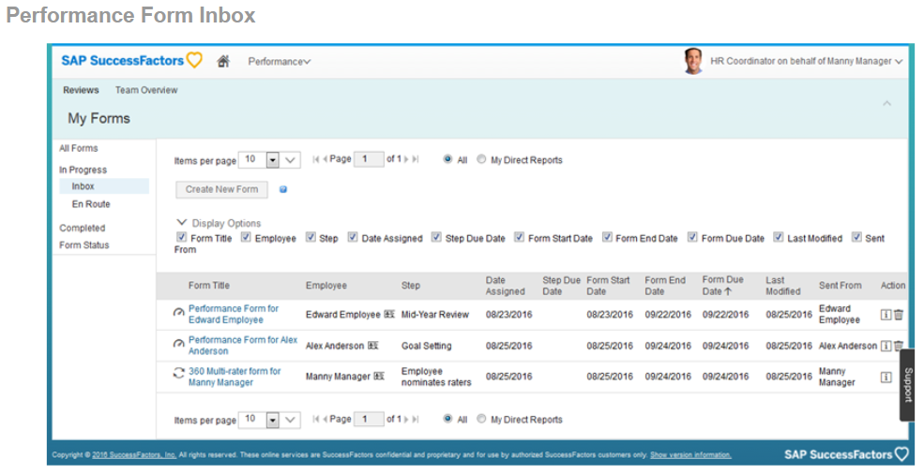
Performance Form Inbox
Alternatively, users can access forms from the Inbox in the Performance module whenever user input is required. Users access this Inbox by clicking the main navigation dropdown arrow and selecting Performance (or the term that refers to this page if the customer uses Text Replacement, for example, Review Forms) from the menu. It is also possible to easily visualize the form status.

Slide 7
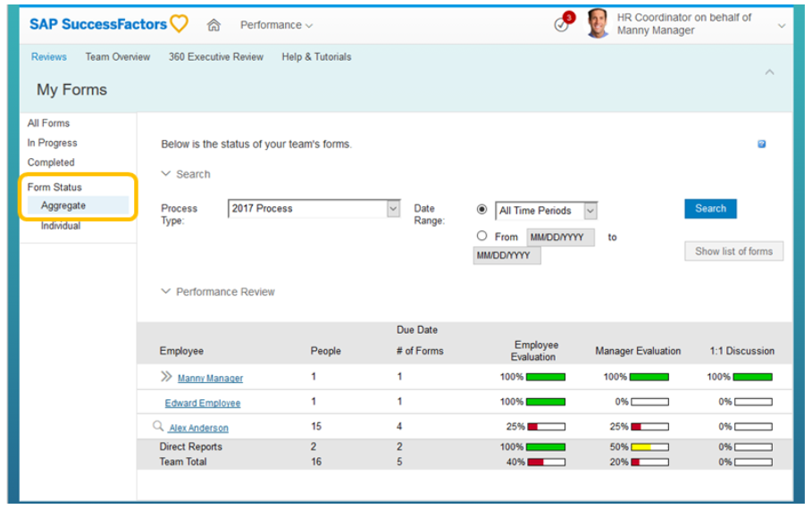
Form Status

Slide 8
Evolution from PMv11 to PMv12 Acceleration
PMv11 is the original format for performance forms that has been available for over a decade. Several years after its release PMv12 was introduced with a new look and feel. However PMv12 (also known as Old PMv12) did not support all of the functionality offered in PMv11. To bridge the gap, PMv12 Acceleration (or PMv12A) was introduced and is now the supported version for creating and maintaining performance forms.
PMv11 and Old PMv12 have been retired and forms based on those versions can no longer be launched. However older form templates created in PMv11 and Old PMv12 can still be upgraded to PMv12A and an exercise on how to do this is included in this course.
Note:
All Performance Management forms validate against the sf-form.dtd. Where the features are the same between the templates, they are configured the same way.

Slide 9
Performance Management Forms
PM Form Version | Features
PMv11 | This was the original format of performance forms in the SAP SuccessFactors system. It was designed to support a multitude of capabilities with underlying best practices.
PMv12 / PM 2.0 | In 2012, a performance form with a new user interface (UI) was introduced to optimize the user experience of the manager. The capability of this form was much less than the PMv11 form, but has a visually-pleasing UI. This form version is sometimes referred to as PM 2.0 because it appears in Manage Templates as Form Type 2.0 (unlike PMv11 and PMv12A form templates which both show as Form Type 1.0).
PMv12 Acceleration | This form combines the functionality of PMv11 forms and the beautiful UI of PMv12 forms. By the 1505 release (May of 2015), almost all functional gaps between PMv11 and PMv12 Acceleration were closed. Since then, support has helped customers upgrade older PMv11 and PMv12 form templates to PMv12 Acceleration.

Slide 10
PMv12 Acceleration
PMv12 Acceleration is enabled by default in Provisioning and has been since Q2 2019 when PMv11 and PMv12 were officially retired. It is important to note that forms based on PMv11 and PMv12 templates can no longer be launched. However PMv11 and PMv12 form templates can still be upgraded to the PMv12 Acceleration format. This process creates a template in PMv12 Acceleration format that copies over all valid configuration information from a PMv11 or PMv12 form template. Users are then prompted to modify any elements from the older templates that are not supported in PMv12 Acceleration.
You work with PMv12 Acceleration in this course. Please follow the information and instructions in the remaining lessons and exercises carefully.

Slide 11
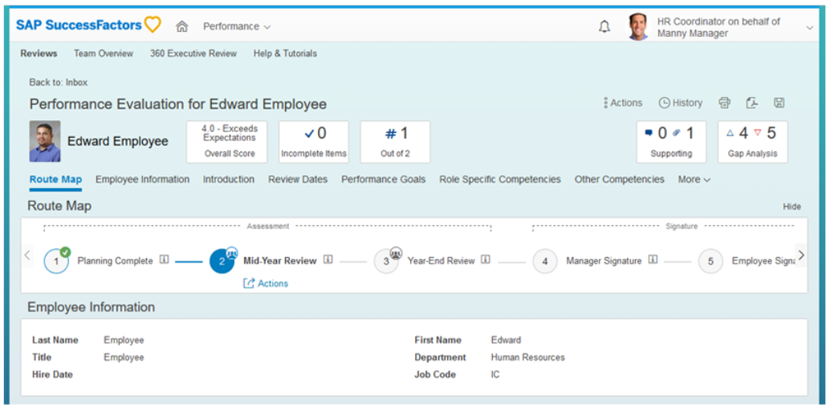
PMv12 Acceleration Performance Review with Fiori Enabled

Slide 12
To Add a New Template to Your Instance
Steps
Navigate to Admin Center → Performance Management → Manage Templates.
On the Manage Templates screen, select the Performance Review tab.
Select Add a New Template.
Results
This option provides template selections from the Success Store.
Select the Performance Review with Self-Review template.
Click Add to my Instance.
On the Save As a New Template dialog box, click Save.

Slide 13
To Convert PMv11 Forms to PMv12 Acceleration
Steps
Log into the Instance and navigate to Admin Center → Performance Management → Manage Templates.
On the Manage Templates screen, select the Performance Review tab, and click the title of the performance template you want to convert.
Results
A yellow triangle appears alongside any performance form that was added before PMv12 Acceleration was turned on in Provisioning.
Select Validate and Approve for PMv12 Acceleration and read the information on the screen that appears.
On the left-hand side of the screen, select the Edit Fields and Sections tab.
Select each of the form sections that appear under the Edit Fields and Sections tab, and note which features are no longer compatible with PMv12 Acceleration in each section. This information appears on the right-hand side of the screen.
Select the Print list of changes button at the top of the screen.Some template changes can be made in Manage Templates, and some changes can only be made in the XML file. There is an automated process that clones the PMv11 form and converts it into a PMv12 Acceleration form, but this option provides you with copies of both XML files to ensure that all customer specifications are taken into account with the new form.
On the Validate and Approve for PMv12 Acceleration tab, select the Update and Edit button at the bottom of the screen and select OK in the dialog box that appears.The automated conversion will clone your PMv11 form and convert it into a compliant PMv12 Acceleration form.
Results
The new PMv12 Acceleration form opens. You can now see the differences between the two versions on the Preview page in Manage Templates.
Click Approve for Launch. The Approve for Launch window appears.
Verify that you want to approve the form for launch in role-based permissions, then launch the new PMv12 Acceleration form by clicking OK.

Slide 14
Establishing Workflow and Recording Evaluations with the Performance Form
About This Topic
In this lesson you learn about the function and use of rating scales and route maps in the performance form.
Objective(s)
After completing this lesson, you will be able to:
Record evaluations with rating scales in the performance form
Identify stages and steps within a route map

Slide 15
Components of the Performance Management Template
A performance form template is a shell that contains the structure, or layout, of the performance review form. It is used to record information, such as the evaluation of an employee’s performance during the review cycle.
PMv12 Acceleration form templates contain the following components:
Rating scale
Route map (form workflow)
Form title
Form sections
*Covered in Lesson 3 in detail

Slide 16
Creating a Performance Form
Form Title:
Every form template must have a title. This title should be descriptive of the form and easy for users to understand. The title is visible in the Performance Inbox and on the open form.
In the figure titled Form Sections, the form title includes both the name of the template and the name of the subject of the form. The name of the template is “Performance Form” and the name of the subject of the form is “Edward Employee”.

Slide 17
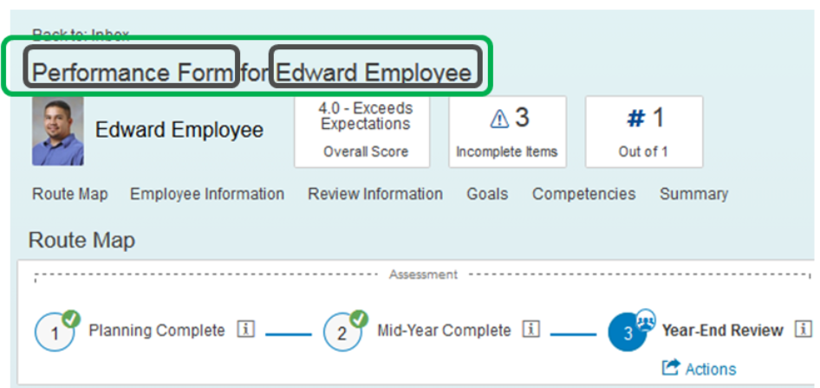
Form Sections

Slide 18
Form Sections
The performance form is made up of a number of sections, as follows:
The Introduction section can include text-based information about the purpose of the review, whom to call for assistance, and any other information relevant to the review.
The Employee Information section identifies the subject of the review (the person whose performance is assessed), and gives other viewers of the form relevant information about the subject.
The Review Information section identifies the review period that the form covers, and the person who created the form.
The Performance Goals section identifies the employee’s individual goals.
These can be populated manually, or automatically from the employee’s Goal Plan.
Each of the Goals and Competencies sections on the form can be weighted independently. The overall performance form score calculation takes these weights into consideration.
Employees and managers can use tools like rating scales, Spell Check, and SAP SuccessFactors’ Legal Scan. Legal Scan detects potentially inappropriate language to avoid legally compromising situations, and to help educate managers about the appropriate language to use during reviews.

Slide 19
Form Sections (Contd..)
The Competencies section identifies the core and role-based competencies the employee is expected to demonstrate.
Competencies can be added manually, or automatically populated.
Multiple Competencies sections can be included on a performance review form. Often, customers use one for core competencies and one for job-specific competencies. Alternatively, one Competencies section can be configured to present both sets of competencies together.
Including core competencies, or values, in the performance review identifies and reinforces the competencies that are expected of all employees.
Including role-based competencies is invaluable given that competencies are fundamental to employee expectations, and sets the stage for career and development planning.
The Summary section provides a summary of the rateable sections of the form in one centralized location.
This section is sometimes titled Overall Performance Summary, or Assessment Summary.
You can also configure the performance form so that managers can manually enter an employee’s overall performance rating in this section.
The Development Goals section is an optional but important section to include and is usually included as part of the end-of-year evaluation to assist in planning for the upcoming year.
The Signature section displays the names of the people who have been asked to sign the form. Once signed, this section displays the electronic signatures of these users and the date the form was signed.
The Objective/Competency Summary section provides a mechanism to generate separate scores for competency and goal ratings, and assign a relative weight to each kind of section.
Because this data is segregated, customers can utilize some very powerful matrix grid reports. These are available through portlets in the Instance.

Slide 20
Describing Roles for Performance Management and Accessing the Document Type Definition (DTD)
About This Topic
In this lesson you learn how roles determine permissions in Performance Management, and how to access the various resources necessary for performance form configuration.
Objective(s)
After completing this lesson, you will be able to:
Identify roles to define Performance Management permissions
Access the Document Type Definition (DTD) and implementation guides
Explain the relevance of ‘order of elements’ within the Performance Management XML template

Slide 21
Roles for Performance Management
Permissions for Performance Management, as with Goal Management, are based on the relationship of the viewer of the form to the subject of the form (the employee being reviewed).
Note: Role Based Permissions do not control permissions within a Performance Management form.
Roles for Performance Management
The following roles can be used to define permissions in the Performance Management form template:
Role Name | Description
* | Everyone
E | Employee
EM | Employee’s Manager
EMM | Employee’s Manager’s Manager
EM+ | Employee’s Manager, all the way up the hierarchy

Slide 22
Roles for Performance Management
Role Name | Description
ED | Employee’s Direct Report
EDD | Employee’s Direct Report’s Direct Report
ED+ | Employee’s Direct Report, all the way down the hierarchy
EMD | Employee’s Manager’s Direct Report (employee’s peers, or co-workers)
EH | Employee’s HR Representatives
F | Form Reviewer (Goal access is restricted through a performance form only)
OP | Objective Parent (for example, a project team lead’s goal that is aligned up from a team member’s goal)
OC | Objective Child (for example, a team member’s goal that is aligned down from a team lead’s goal)
EP | All of the employee’s matrix managers
EX | An employee’s primary matrix manager

Slide 23
The Document Type Definition (DTD)
The DTD used for all versions of the Performance Management form is the sf-form.dtd. When you are making changes to the XML, remember to save and validate the document after every single change, and fix errors as needed.
It is always quicker to validate the XML against a downloaded version of the DTD that will be placed in the same folder as the XML.
Note: You must change the first few lines of the XML code as shown in the figure titled Working With the DTD.
Regarding the sf-form dtd:
There are features in the DTD that have never been supported in all versions of SAP SuccessFactors Performance Management.
There are features in the DTD that are not supported in PMv12 Acceleration.
Just because something is in the DTD does not mean it is thoroughly tested every release. Always follow this rule: If it is not found in the implementation guide with thorough documentation, then think twice about using it. If you use something new, always test it thoroughly, document the change, and verify with SAP Support that your configuration change is officially supported by the product.
The DTD is updated when features are added or changed, but it is not maintained beyond those scenarios.

Slide 24
Performance Management Template Configuration
About This Module
Module Knowledge
Listing Provisioning Features Commonly Enabled in Performance and Goal Management
Using the Performance Management Template
Managing Performance Management Template Settings
Managing the Performance Form
Adding and Modifying Sections in Manage Templates and XML
Configuring Section Attributes in the Performance Form

Slide 25
Listing Provisioning Features Commonly Enabled in Performance and Goal Management
About This Topic
In this lesson, you will receive an overview of the Provisioning features that are commonly enabled in Performance and Goals Management. You will also learn how to configure and customize form templates.
Objective(s)
After completing this lesson, you will be able to:
List Provisioning features commonly enabled in Performance and Goal Management

Slide 26
Provisioning in Performance Management
As with Goal Management, in Performance Management you work with a template to configure it to the specifications of your customer. There are several steps that you must take to prepare for configuration.
Enablement of Provisioning Features
There are a number of features available to you when you enable the Performance and Goals Management product. You configure these features in Provisioning, under the Company Settings section of your company’s Instance.
You cannot enable all of these options at the same time. What you enable is based upon what the customer has purchased and what they want enabled.

Slide 27
Configuration of Performance Options
The following is a list of commonly enabled features:
Performance Appraisal Smart Form
This switch enables the Performance Management module and is needed to access to Performance Management options in Admin Center.
Writing Assistant
This switch enables the writing assistant tool for competencies which appear in a company instance in Manage Competencies as well as in Form Template Settings.
Admin Configuration Tool
This switch enables Admin Center access within an instance.
Workflow
This switch enables Route Maps which are needed by Performance Forms and 360 Multi-Rater Forms.
Competency Library Management Suite
360 Degree Multi-Rater
Graphical Report (360) — requires ”360 Multi-Rater”
Legal Scan
Spell Check
Live Profile
Language Pack
English US
Managing Documents
Left Navigation
Matrix Grid Report (9–box)
Plus UI
Version 10 UI

Slide 28
Configuration of Performance Options
The following is a list of commonly enabled features (Contd..):
Manage Users (enables the addition of users in Admin Center)
SuccessFactors Notification Feature (this requires 2 to 4 hours to take effect)
Performance Management Todo Mobile Notification
Version 12 UI framework (Revolution)
Field used to group users to themes: division
Version 11 UI framework (ULTRA)
Ultra Organization Chart (Version 10 UI or Version 11 UI framework ULTRA required)
Rich text editor for Performance Management and 360 Degree
Stack Ranker (Version 11 UI framework ULTRA required)
Enable calibration
Enable Calibration Executive Review
Enable Manager Calibration Session
Enable Enforce Comment Option in Views
Enable Mobile Access (Admin UI V1)
Profile v12 (once enabled, you cannot return to the v11 profile)
Enable Public Profile
Performance Management v12 — requires Version 12 UI framework (Revolution)
Admin 2.0 (OneAdmin) — requires Version 11 UI framework (ULTRA)
Enable Performance Management Access Permission
Enable Advanced Find User Component
Enable Media Service Features (Show Me, About Me, My Name)
Requires Version 12 UI framework

Slide 29
Goal Frameworks
The following features help you to manage goals:
Goal Management Suite (select Total Goal Management from dropdown menu)
TGM Version 10 UI — requires Total Goal Management
My Goals Tab — V10 and ULTRA require Total Goal Management
Enable the GM-PM Sync up
CDP Full (Development Plan)

Slide 30
Analytics and Dashboards
The following features manage and produce reports:
Analytics Tab (Reporting button in V9)
List views (Dashboard Drilling)
Spotlight Views
Spreadsheet Reports
Classic Reporting
Ad Hoc Report Builder Standard Reports Bins
Ad Hoc Report Builder
Goal Management
Employee Profile
Calibration Activity
Performance Management
360 Degree Multi-Rater Subject
Calibration
Turn on on-demand dashboard option

Slide 31
Web Services, the Home Page, and Documents
The following features are available in web services, in home page settings, and describe the limits of attachments:
Web services
Partner Web Service
SF Web Service
Home Page Settings
Show ToDo Portlet
Document Attachment
Attachment Storage Allocation — 1G
Attachment user limit — No limit
Attachment max file size — 5M
Attachment Limit Notification Monitor Period — Never

Slide 32
Performance and Goal Management Features Available in Admin Center
Remember that some features that are turned on and off in Provisioning can also be turned on and off in Admin Center by an Administrator. These can be accessed as follows:
Performance Management: Admin Center → Performance Management → Performance Management Feature Settings
Goal Management:
Admin Center → Goal Management → Goal Management Feature Settings

Slide 33
Performance Management Feature Settings Available in Admin Center
Enable Continuous Performance Management: This feature enables users to get quick feedback on work through frequent and structured conversations with manager. It help managers track their team members' progress effortlessly and offers a simple way to provide coaching advice. To enable this feature you need to have Generic Objects and Role Based Permission features.
Stack Ranker for Performance Management - Enable display of all forms but self: Controls whether or not Team Rater (aka Stack Ranker) can be used by raters other than the Direct Manager. When enabled, other raters such as the Matrix Manager or the EMM, can rate a user using Team Rater.
Enable Performance Management Access Permission: Performance Management Access Permission is a feature that allows customers to hide the Performance tab from employees using role based permissions. While this permission can be used to disable access to the Performance tab, it is important to note that users who have Performance Management or 360 Forms in their inbox folders, will continue to see the Performance tab even without Performance Management Access permission. If this is the case for the user, the only way to hide the Performance tab is to delete all the forms in their folders.
Enable Team Overview Access Permission: Checking this flag enables the manager to access the performance status summary of the direct reports on the Team Overview page.

Slide 34
Performance Management Feature Settings Available in Admin Center
Disable the internal scroll bar next to forms (PM v11 Only): Checking this flag disables the internal scrollbar but enables the browser scroll bar. Conversely, unchecking this flag enables the internal scroll bar but disables the browser scroll bar.
Hide Delete Icon inside form: Enabling this flag removes the delete button from inside the form if the delete button is enabled in Form Template Settings. It is still visible from the Inbox view.
Enable Team Rater for Performance Management: Enables the team rater (stack ranker) feature. Team rater allows raters to quickly review the rating for those they are evaluating and visualize how subjects compare with or stack up against one another.
Enable PM Form Search Competencies (PM v11 Only): By enabling this feature, when the user is in the competency section, he can search for any competency beyond those associated with his job role.
Rich text editor for PM and 360: Enables RTE for both PM and 360 modules. An online rich-text editor allows users to edit rich text and presents a what-you-see-is-what-you-get (WYSIWYG) editing area.
Rich text editor gives confirmation cleanup on text pasted from MS-Word: Provides an option to users to override the universal functionality of automating the text cleanup from MS-Word.

Slide 35
Goal Management Feature Settings
Disable TGM link in Quick Cards: Disables the link to go plans via quick cards. Quick Cards are the small rolodex-card icons shown next to each employee’s name in most name lists in the system. Disabling the link will disable the link to goal plans globally from the quick cards.
TGM/CDP Goal Transfer Wizard: SuccessFactors Goal Management has the ability to enable "Copy Goal From Other Objective Plan". Using this feature, it is also possible to transfer a goal from one plan to another in a few simple steps. This feature is to allow a user to copy from their own goal plans, not from another person's plan.
Enable Goal/Objective Management Access Permission — requires "Version 11 UI framework (ULTRA): This provides the ability to allow you to hide the Goals tabs from the navigation of the system for specified users.
Goal Import: Enables a feature that allows users to import goals and goal related data into the system via batch
Enable Group Goals / Group Objectives 2.0: Enables Group Goal 2.0 – which allows the creation of group goals 2.0, which supports tasks/targets/milestones, calculated rating and allows fields to be made editable by group goal members

Slide 36
Goal Management Feature Settings
Enable target population for group goals: Some permissions can only be exercised with the presence of a people group (target population), which the permissions can act upon. A target population is a group of users whom the granted users above can have access to. For example: Your organization has 5 departments, but you only want Administrator Joe to Change User Information for Department A only. In this case, the target is 'Department A'. With this switch, ﻿Admins can set up permission roles for viewing goal plans and assigning group goals separately.
Enable Team Goals – Enables the Team Goal feature in the application and provides permissions to grant appropriate access. Team Goals has been designed using the existing Group Goals 2.0 framework and supports all the feature of Group Goals 2.0
Enable Initiatives – Enables to create departmental, corporate and division level initiatives and allows employees to actively associate their personal Goals to the Initiatives. This feature greatly helps when you work with Goals that are specific to departments and divisions.
Enable Delete Team Goals Share - Enables you to share Team Goals with other users and grant them the right to delete the Team Goals as well. This permission allows primary owner and the co-owners of Team Goals to delete the goals;

Slide 37
Using the Performance Management Template
About This Topic
In this lesson, you will learn how to grant form creation permissions and copy and update a Performance Management template.
Objective(s)
After completing this lesson, you will be able to:
Copy the Performance Management Template
Describe the methods of form creation permissions
Identify the methods of updating Performance Management Templates

Slide 38
The Performance Management Template
The template you start with already has some basic features configured. You can modify these features according to the needs of the customer. Because the template is coded in XML, you can choose to modify it in a text editor, or, preferably, in an XML editor. You can also perform many modifications directly in Provisioning, avoiding the need to upload new versions of the XML. Performance Management templates are available in the SuccessStore. You can access these templates and add them to the Instance in the same way as goal plan templates.

Slide 39
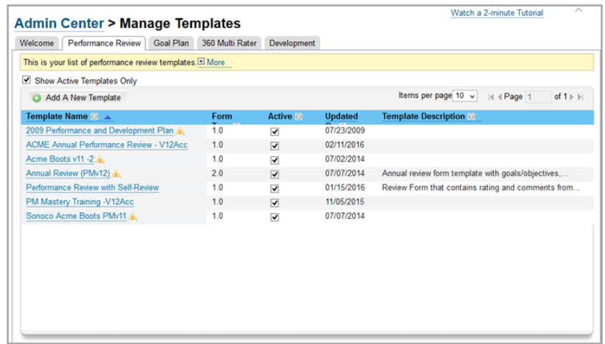
To Copy a Performance Management Template
Use the following steps to copy the existing Performance Management template:
Steps
Navigate to Admin Center → Manage Templates → Performance Review
Click on the Performance and Development Plan, which is designated as Form Type 1.0.
In the template, click Save As....
In the Save As.. dialog box that appears, enter the name and a description for the form, and click Save.The new template is listed under the Performance Review tab of Manage Templates and is ready for configuration.

Slide 40
Form Creation Permissions Granting
When you set up role-based permissions, certain roles are given the permission to create performance forms. If you have a customer that wishes to use traditional permissions, you must grant the permissions for performance form creation. There are two ways to do this, which are shown in the figure, Assigning Form Creation Permissions.
Permission | Description | Implementation
Default User Permissions | Grants every user in the instance the permission to create Performance Management forms. | This permission is used during testing. However, it is selective and is rarely used for customer production instances because of the far-reaching impacts.
Controlled Access | Grants certain individuals in the organization the permission to create Performance Management forms. | This is configured through Admin Center → Performance Management → Form Creation Permission.

Slide 41
To Grant Form Creation Permissions
Within a testing or a training Instance, you can allow everyone in the Instance to create Performance Management forms for themselves and (if applicable) their direct reports.
Steps
Log in to the Instance as an admin user.
Under Manage Employees, click Set User Permissions.
Click Default User Permissions.
Under Form Permissions, select the checkbox next to Form Creation for the template you are permissioning.
Scroll to the bottom of the page and click Save.

Slide 42
Methods of Updating Performance Management Templates
You can update Performance Management Templates in the following ways:
You can update the template in Admin Center.
You can update the template in XML using an XML editor.
You can update the template in Provisioning.

Slide 43
To Update the Template in Admin Center
You can make many changes to the template through Admin Center.
Steps
Log in to the Instance as the admin user.
In Admin Center, under Performance Management, select Manage Templates.
Select the Performance Review tab to see all of the Performance Management templates.
To see a preview and configuration options, select the template of your choice.

Slide 44
Template Updates using an XML Editor
Make sure that you validate the template against the DTD frequently, and each time you make a major update, create a new save file (version1, version2, version3, and so on). This version control helps you to troubleshoot.
When you are ready to upload your new XML file into the system, you upload the file through Provisioning.
You may also make edits to the XML directly in Provisioning for PMv12 Acceleration forms. Provisioning breaks up each chunk of code by section, but you must be careful to place new code in the correct order within each section. You may also add new sections, delete sections, and move the sections around to change the order.

Slide 45
To Update the Template in Provisioning
Steps
Log in to Provisioning.
In the Company Name column, click your company’s Instance.
Click Form Template Administration.
Click the template that you wish to update.
Click Save Form each time you make any updates to the XML in Provisioning.

Slide 46
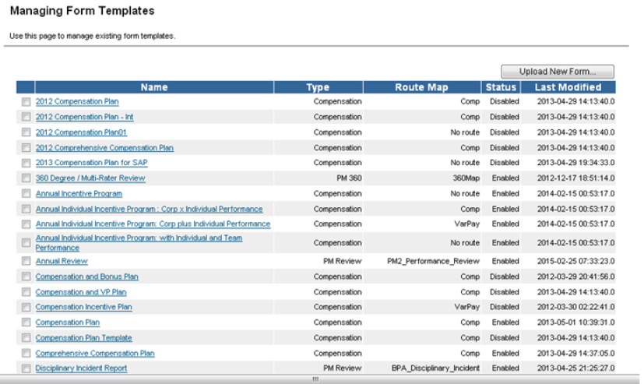
To Download the Template
After you upload the template, you might want to make additional changes within the XML. To make additional changes, you must download the updated XML from the Instance.
Steps
Log in to the Instance as an admin user.
Navigate to Admin Center.
Under Performance Management, select Form Template Settings.
Click the template you wish to modify.

Slide 47
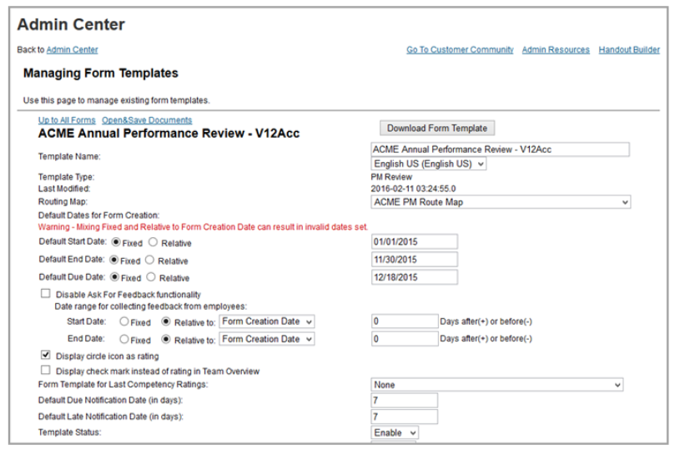
To Download the Template
Steps
5. On the Managing Form Templates page, click Download Form Template.

Slide 48
To Upload the Template
If you have made changes directly in the XML using an XML editor, you must upload the XML through Provisioning:
Steps
Log in to Provisioning and select the company Instance..
Scroll down to click Form Template Administration.
Select the form you want to update.
Click Update by Upload.
Click Browse to navigate to your saved template, and then click Upload Form Template.Your template is updated in the Instance, and you can modify or launch it from Admin Center.

Slide 49
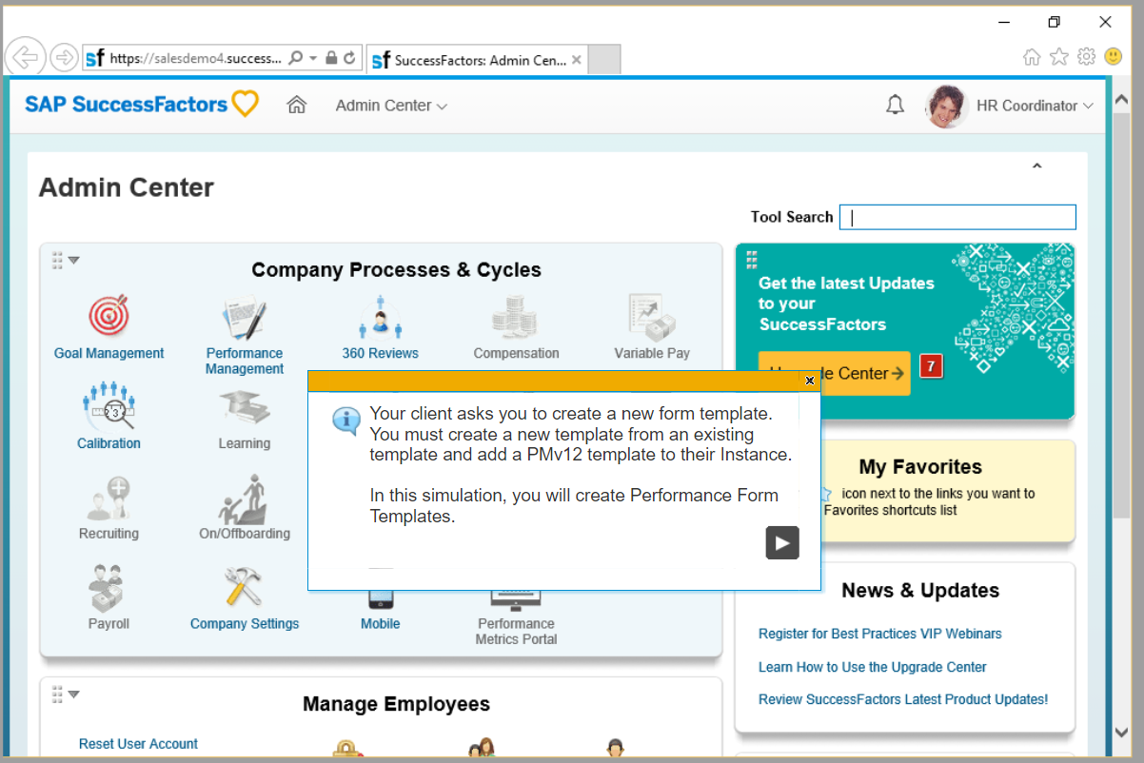
Exercise: Create Performance Form Templates

Slide 50
Managing Performance Management Template Settings
About This Topic
In this lesson, you will identify email notifications for Performance Management, and modify general settings in Manage Templates and XML.
Objective(s)
After completing this lesson, you will be able to:
Modify general settings in Manage Templates and the XML file
Identify Performance Management email notifications

Slide 51
Modification of Template Settings
There are several form templates available through the SuccessStore. They are available in the Manage Form Templates area of Admin Center. Although you can use existing forms as is if they meet the customer’s needs, generally you must modify the forms. Before you modify a form, save a new template with a new name. Make modifications to the new template only. To modify a form template, you change its existing elements or add new elements. We recommend that you copy the form template year after year — employee data changes can impact the form template, even after it is closed.

Slide 52
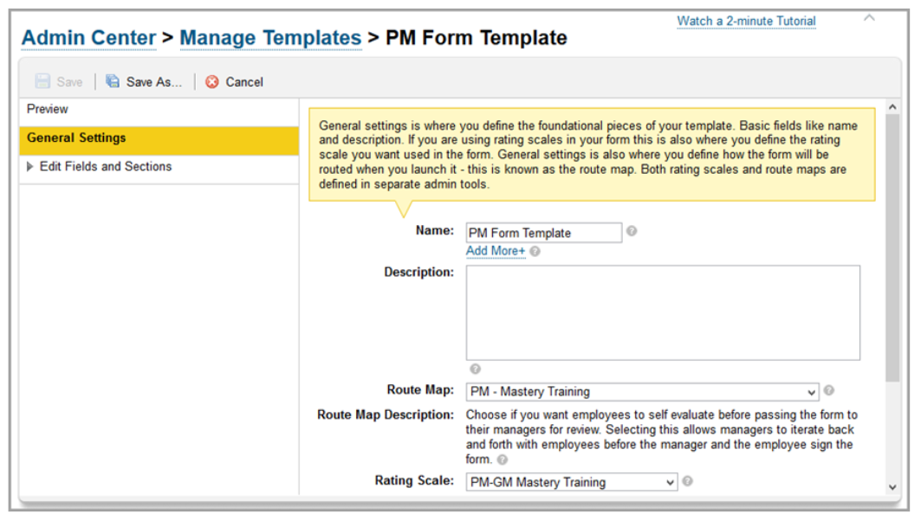
The General Settings Section
You can define the foundational pieces of the template in the General Settings section. Here, you can edit the name of the template and the description, as well as select the workflow (route map) and rating scale.

Slide 53
Modification of the General Settings Section
You can configure the following items through General Settings:
Name: The name of the template.
Description: This is a description of the form template that does not show up anywhere but in the XML. It is used to make notes.
Route Map: Associate the route map that the forms create from this template should follow.
Route Map Description: This area automatically populates with the description you assigned to the route map when it was created.
Rating Scale: Associate the rating scale that must be used in the template here.
Hide Numerical Rating Values: If checked, this option makes ratings appear only as their text label.
Unable to Rate: The text entered into this field is used if an employee cannot be rated for some reason.
Text entered in this field shows as a part of the rating scale, but it is not included in the overall rating. It’s the equivalent of Not Applicable.
Allow Managers to Stack Rank Employees on Competency Sections: Enables the stack ranker (also known as Team Rater) function, if the function has also been turned on in Provisioning.
Advanced Settings: Clicking this link opens a window with more advanced General Settings.
You can also access this window through Admin Center → Performance Management → Form Template Settings.

Slide 54
Advanced Settings
Advanced Settings are also known as Form Template Settings. These settings allow for management of different elements of a form’s behavior.
You can configure the following settings in Form Template Settings:
Default start, end, and due dates.
Automatic manager transfer and inactive employee options.
On and off settings.
Note:
When configuring the advanced settings, it is very important to know whether the changes affect existing (launched) forms or only forms created after the change is made. For a list of settings and the forms that are affected, see the “Form Template Element” document on the Performance and Goals JAM Page or the Learning Room.

Slide 55
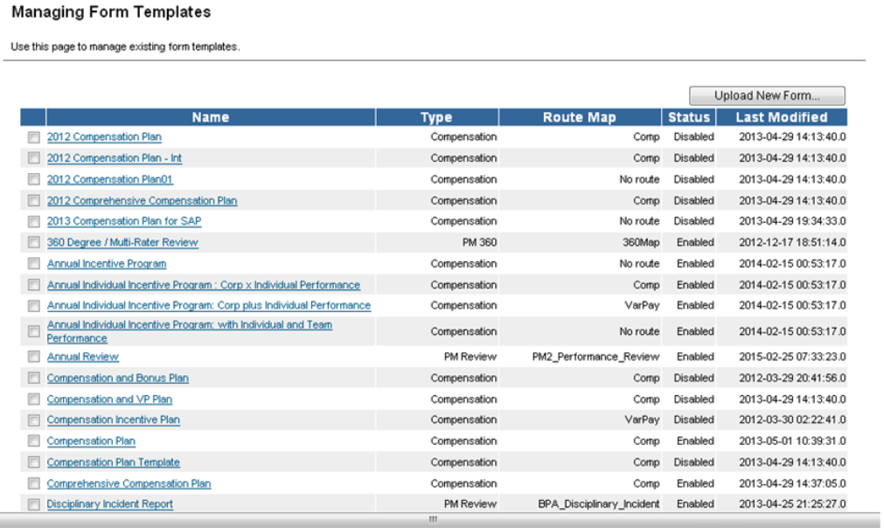
Form Template Settings

Slide 56
Default Start, End, and Due Dates
Each performance form is intended for the review of employees within a specified time frame. These dates can take a number of forms:
Fiscal year, calendar year, or some other time period.
Fixed dates where the start, end, and due dates are specified or relative to a number of days before or after form creation date can be entered.
Fixed dates or relative to form creation date, default start date, and default end date.
When a form is launched, the dates entered in this section can be used for the form.

Slide 57
Automatic Manager Transfer and Inactive Employee Options
You must select this option if you want to transfer documents to a new manager during the review cycle based on a new user import.
If you select the Automatic Manager Transfer option, documents are transferred based on what is selected in the checkboxes.
If there are documents for a certain template that must not be removed when an employee becomes inactive, you can override by using the Do Not Remove Inactive Employee’s In-Progress Documents and Do Not Remove Inactive Employee’s Completed Documents options.

Slide 58
On and Off Settings
Enable and Disable Spell Check and Legal Scan: You enable and disable these options in Provisioning.
Enable Rich Text Editing of Comments Field: This option allows a user to add color, change font size and styles and add hyperlinks. This is enabled and disabled in Provisioning.
Enable Writing Assistant: This is enabled and disable in Provisioning.
Disable Ask for Comment Routing/Disable Edit Routing: When these options are both activated, users will not see the Get Feedback option on the form.
Display the Signature Line when a Signature Step is skipped.
Disable Buttons: This option allows users to enable and disable the Delete button, the 360 Degree button, and the Send button for completed documents.

Slide 59
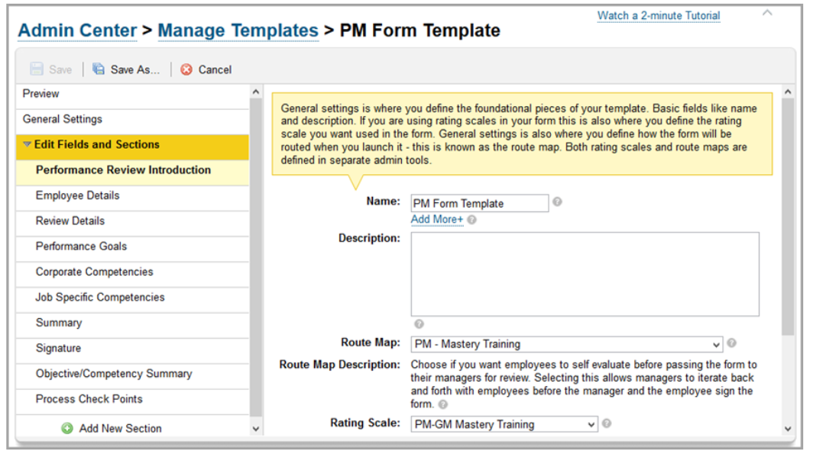
Field and Section Editing
Edit Fields and Sections is where the elements of the form are customized, and where sections are added or deleted. There are several different kinds of sections that can appear on a performance form template. How to configure each of these sections in Admin Center and XML is covered in this course.

Slide 60
XML File Editing
The general settings in the XML are located in the <fm-meta> section of the code. In this section, you may attach a default rating scale to be used throughout the performance form (<scale-id>), enable certain buttons that are visible on the form (<enable-previous-step-button>,<enable-delete-button>), and enable stack ranker (<my-team-rater/>).
If you choose to set up the general settings in the XML, make sure to log in to the instance to Admin Center → Performance Management → Form Template Settings, and associate a route map to your performance form. You may also set up attributes of the form including spell check, legal scan, writings, and turn on/off various buttons. The following is an example of a typical performance form meta section:

Slide 61
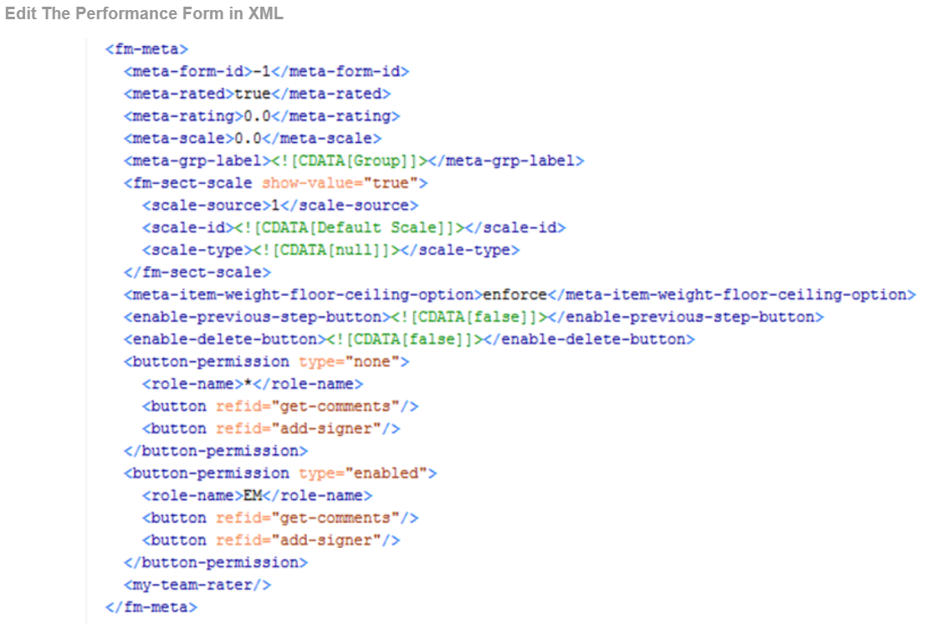
Edit The Performance Form in XML

Slide 62
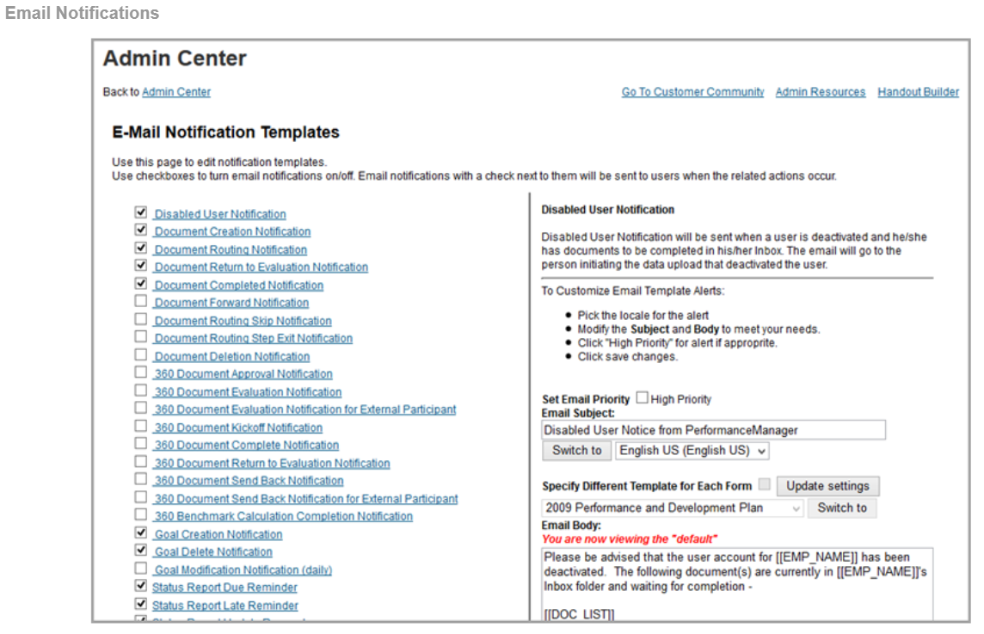
Email Notifications

Slide 63
Turn Email Notification Templates On or Off
From Admin Center → Company Settings → Email Notification Templates, you can turn on or off various templates on the left-hand side of the screen, and edit the content of the templates on the right-hand side of the screen. You may want to enable additional notifications as you enable modules.

Slide 64
Typical Email Templates
Here is a list of the typical email templates used with the basic Performance Management Product:
Disabled User Notification
Document Creation Notification
Document Route Notification
Document Return to Evaluation Notification
Document Completed Notification
Document Forward Notification
Document Routing Skip Notification
Document Deletion Notification
Document Due Notification
Document Due Notification for External Participant
Document Late Notification
Document Late Notification for External Participant
Performance Evaluation Kickoff Manager Notification
Performance Review Process Update for Manager

Slide 65
Summary
In this lesson, you have learnt:
Explain the basic principles of Performance Management
Convert a Performance Management form to PMv12 Acceleration
Create a performance form
List Provisioning features commonly enabled in Performance and Goal Management
Copy the Performance Management Template
Describe the methods of form creation permissions
Identify the methods of updating Performance Management Templates
Modify general settings in Manage Templates and the XML file
Identify Performance Management email notifications

